Slide 1


• We’ll start in a moment :) • We may record tonight’s event and plan to take screenshots for social media. • If you want to remain anonymous, change your name & keep video off. • We’ll introduce the hosts and break in-between for Q/A. • We will make some time for Q&A at the end of the presentation as well. • Online event best practices: • Mute yourself when you aren’t talking. • We want the session to be interactive. • Feel free to unmute and ask questions in the middle of the presentation. • Turn on your video if you feel comfortable
Check out:
• Technical Tracks • Check our Digital Events • Get updates – join the Digital mailing list • Give us your feedback – take the Survey
Copyright © 2021 by Prachi Shah
Welcome!

Slide 2

Copyright © 2021 by Prachi Shah
WWCode Digital + Backend
Backend Study Group
June 3, 2021

Slide 3
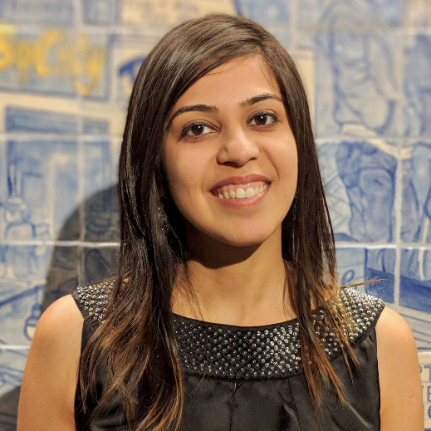
• Welcome from WWCode! • Our mission: Inspiring women to excel in technology careers. • Our vision: A world where women are representative as technical executives, founders, VCs, board members and software engineers.
• Software Design Patterns [Part 3 of 5] • Creational Design Patterns [4/22] • Structural Design Patterns [5/20]
• Behavioral Design Patterns [6/3] • Anti-patterns [6/17] • Interview Questions [7/1]
• What is Backend Engineering?
• Software Design
Copyright © 2021 by Prachi Shah
Introduction & Agenda
Prachi Shah
Senior Software Engineer @ Metromile

Slide 4
• What is Backend Engineering?
• Design, build and maintain server-side web applications. • Concepts: Client-server architecture, API, micro-service, database engineering, distributed systems, storage, performance, deployment, availability, monitoring, etc.
Software Design • Defining the architecture, modules, interfaces and data. • Solve a problem or build a product. • Define the input, output, business rules, data schema. • Design patterns solve common problems. • 3 Types: • UI design: Data visualization and presentation. • Data design: Data representation and storage. • Process design: Validation, manipulation and storage of data.
Copyright © 2021 by Prachi Shah
Backend Engineering

Slide 5
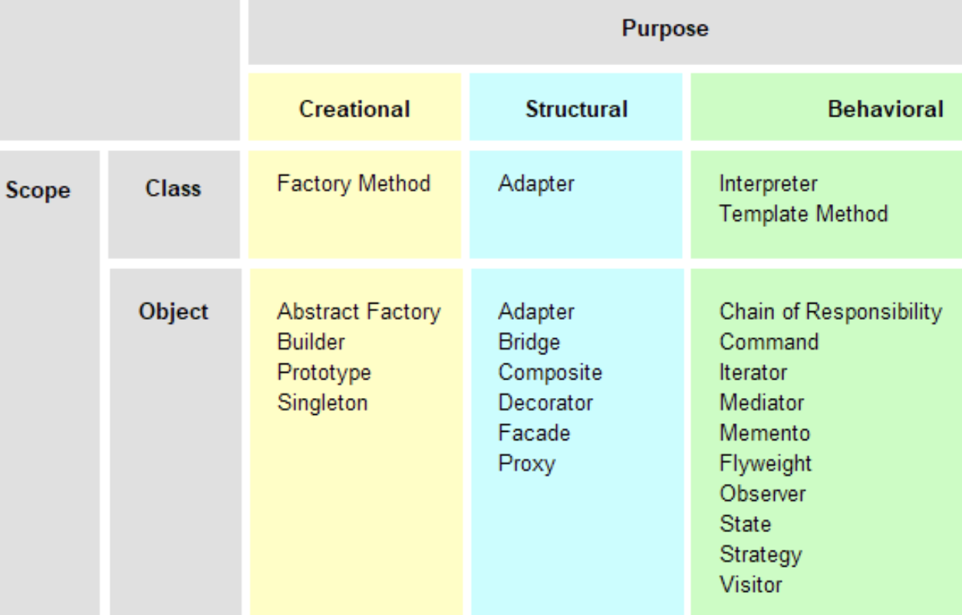
Copyright © 2021 by Prachi Shah
Backend Engineering
Design Patterns • Set of template solutions that can be reused. • Improved code maintainability, reusability and scaling. • Leverages Object-oriented programming (OOP) principles for flexible and maintainable designs. • Shared pattern vocabulary. • Not a library or framework, but recommendations for code structuring and problem solving. • Adapt a pattern and improve upon it to fit application needs. • Defines relationship between objects, loosely coupled objects, secure code.

Slide 6
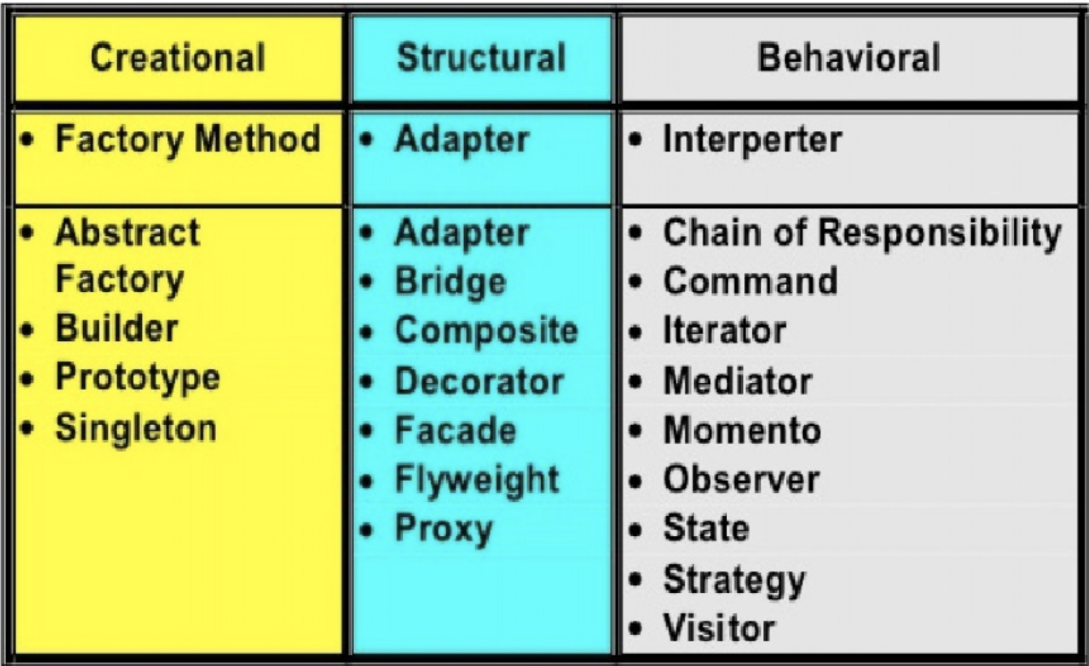
Copyright © 2021 by Prachi Shah
Backend Engineering
Types of Design Patterns • Creational: • Initialize a class and instantiate the objects. • Decoupled from implementing system. • Singleton, Factory, Builder. • Abstract Factory, Prototype. • Structural: • Class structure and composition. • Increase code reusability and functionality. • Create large objects relationships. • Adapter, Facade, Decorator, Bridge, Composite, Flyweight, Proxy. • Behavioural: • Relationship and communication between different classes. • Observer, Strategy, Iterator, etc.

Slide 7


Copyright © 2021 by Prachi Shah
Backend Engineering
• What are design patterns?
• What is a creational design pattern?
• What is a structural design pattern?
• Can you give examples?
You can unmute and talk or use the chat.

Slide 8
Copyright © 2021 by Prachi Shah
Backend Engineering
Object-Oriented Programming Concepts:
• Inheritance and super(): subclass inherits methods and attributes of superclass. super() inside subclass constructor to pass attributes.
• Polymorphism: same method but different behavior. • Overloading: Same name method but different parameters. • Overriding: Method signature (name & parameters) same in subclass and superclass.
• Abstract class: • Has abstract and concrete methods. Declare vs. Define variable and method. • Objects that extend (one) class have same/default behavior & can be overridden.
• Interface: • Has abstract methods only. Uses implements keyword. • Polymorphic behavior for objects that implement Interface(s).

Slide 9
Copyright © 2021 by Prachi Shah
Backend Engineering
• What are the OOP concepts?
• Can you give examples?
You can unmute and talk or use the chat.

Slide 10
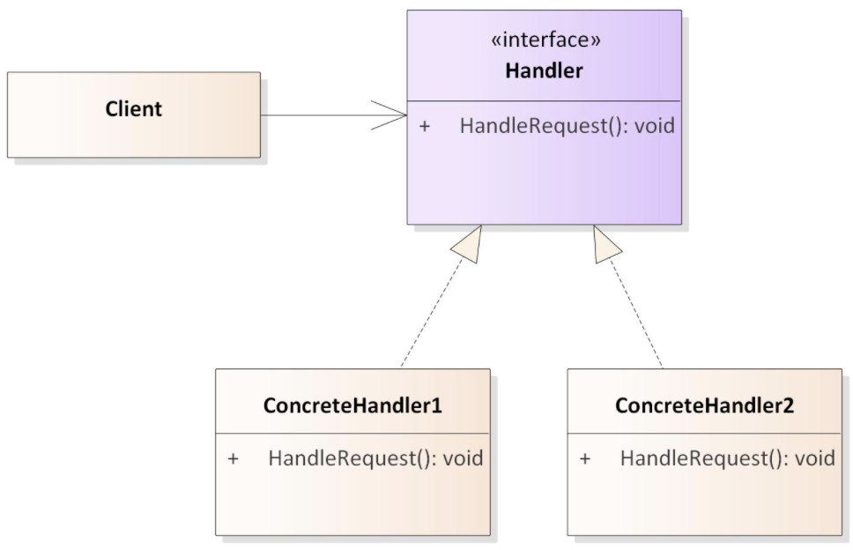
Copyright © 2021 by Prachi Shah
Backend Engineering
Behavioral Design Patterns: • Chain of Responsibility: • Sender object sends request to a chain of receiving objects to eventually reach the receiver object. This avoids coupling between sender object and receiver.
• Links receiving objects together in a chain of objects.
• Once an object independently handles the request, it is sent to the next object in the chain.
• These “handler” objects are determined at runtime.
• Handler: Interface that receives a request and sends it to the next handler object.
• Concrete Handler: Sequential handler objects in the chain.
• Sender: Originates the request and references the Handler.
• Example: Shipment delivery. Package --> shipping state 1 --> state 2 --> Receiver • Code example.

Slide 11
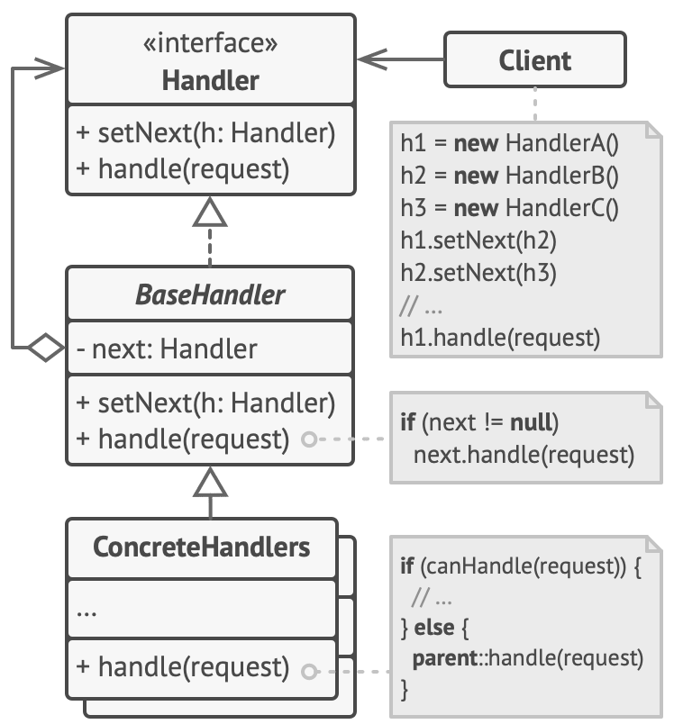
Copyright © 2021 by Prachi Shah
Backend Engineering
• What is a Chain of Responsibility design pattern?
• Can you give examples?
You can unmute and talk or use the chat.

Slide 12
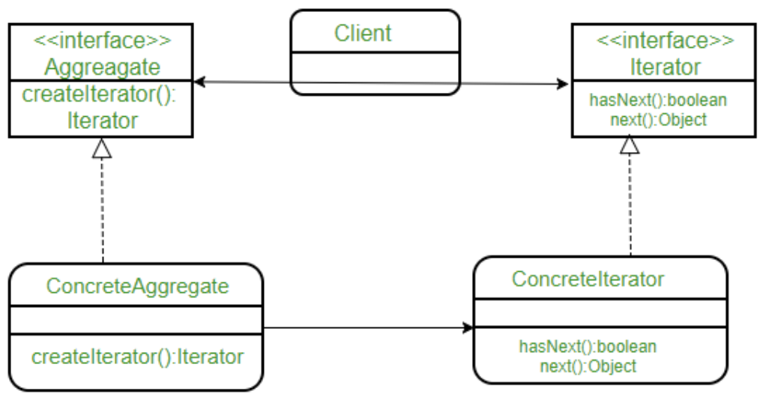
Copyright © 2021 by Prachi Shah
Backend Engineering
Behavioral Design Patterns: • Iterator: • Traverse a collection of objects in a specific manner. AKA cursor.
• Access elements without revealing the implementation.
• Iterator:
• Interface with methods to iterate over a collection (of any type).
• Different simultaneous iterations: one-way and bi-directional.
• Concrete Iterator: Implements the Iterator. Tracks current position in traversal.
• Aggregator: Collection Interface to create an Iterator.
• Concrete Aggregator: Returns an instance of Concrete Iterator.
• Example: Directory of names: Search alphabetically, search from start or from end.
• Code example.

Slide 13
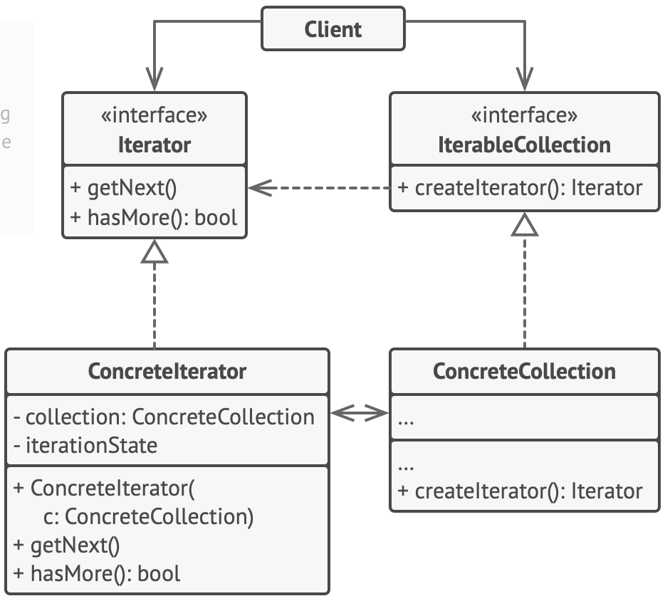
Copyright © 2021 by Prachi Shah
Backend Engineering
• What is a Iterator design pattern?
• Can you give examples?
You can unmute and talk or use the chat.

Slide 14
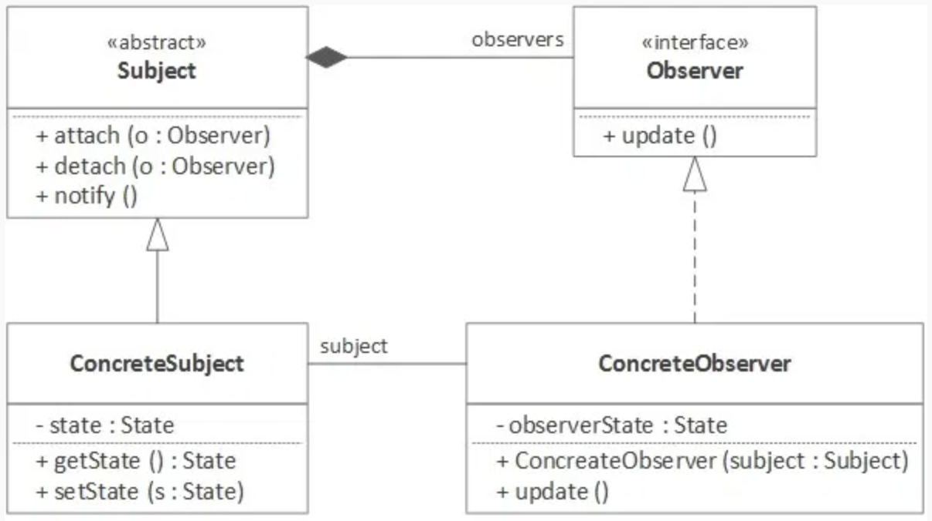
Copyright © 2021 by Prachi Shah
Backend Engineering
Behavioral Design Patterns: • Observer: • Define 1-1 dependency between objects.
• On change of state in one object, dependant objects are notified and updated.
• AKA broadcast communication or subscribe-publish.
• Objects can be same/different but implement the same Observer interface.
• Observable: Objects state change is of interest.
• Observer: Registered objects that are notified on Observable’ state change.
• Common functions: add(), remove(), hasChanged().
• Example: Marketing & new products notifications. Kafka Pub/Sub.
• Code example.

Slide 15
Copyright © 2021 by Prachi Shah
Backend Engineering
• What is a Observer design pattern?
• Can you give examples?
You can unmute and talk or use the chat.

Slide 16
Copyright © 2021 by Prachi Shah
Backend Engineering
Behavioral Design Patterns: • Strategy: • Select one out of different strategies/ algorithms/ implementations at runtime.
• AKA Policy.
• Add strategies in separate classes that the client references w.r.t. the context.
• Strategy: Interface with methods to implement the strategy (Example: Sorting).
• Context: Determines what strategy and respective implementation to select.
• Implementation: Various Strategy implementations (Example: Merge, Quick, etc.).
• Open/Closed principle:
• Open: Objects extended to select strategies/implementations.
• Closed: Context and objects not modified.
• Example: Sort (algorithms) a collection of objects (List, Set, etc.).
• Code example.

Slide 17
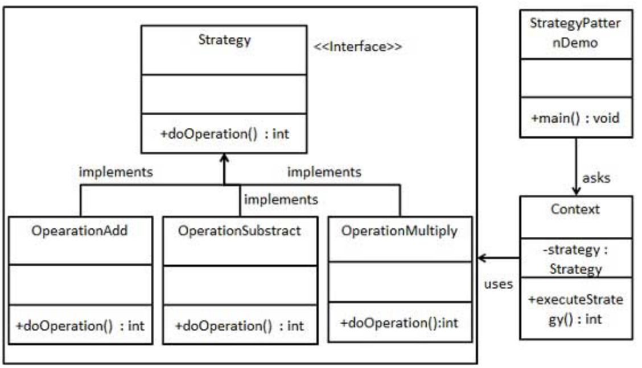
Copyright © 2021 by Prachi Shah
Backend Engineering
• What is a Strategy design pattern?
• Can you give examples?
You can unmute and talk or use the chat.

Slide 18
Copyright © 2021 by Prachi Shah
Backend Engineering
Summary:
• Behavioral design patterns: Focus on relationships and communications between different classes.
• Chain of Responsibility: Sender object sends request to a chain of receiving objects to eventually reach the receiver object.
• Iterator: Traverse a collection of objects in a specific manner.
• Observer: Define 1-1 dependency between objects. Subscribe to the Observable.
• Strategy: Select one out of different strategies at runtime.
NEXT SESSION on 6-17-2021: Anti-patterns
You can unmute and talk or use the chat.

Slide 19
• WWCode Presentation and Demo
• WWCode YouTube channel:
• March 25, 2021 session recording: Backend Engineering
• April 8, 2021 session recording: Java Microservice and REST API Demo
• April 22, 2021 session recording: Creational Design Patterns
• May 20, 2021 session recording: Structural Design Patterns • Resources:
• Software design pattern
• Design Patterns in Java • Design patterns • Design Patterns • Head First Design Patterns book You can unmute and talk or use the chat.
Copyright © 2021 by Prachi Shah
Backend Study Group

